Slide 1

House Price ANALYSIS

Slide 2

Why this topic
Majority of the people would like to settle down at some point of life, eventually we would all need to buy a property. House price could directly affect to the plan of life.

Slide 3

Group 3
Franco
Nasrin
Catherine
Joseph

Slide 4

Key Step for the analysis
Look for historical data
Determining the factors that will affect the house price and search for relevant dataset.
Set up hypotheses
Dig deep into the factors by analyzing the data that we have
Notes:
Obtain the sold property record in all Melbourne Region from 2016-2018
The neighborhood quality and amenities impact
Fine tune the analysis to find the correlation between the factors

Slide 5
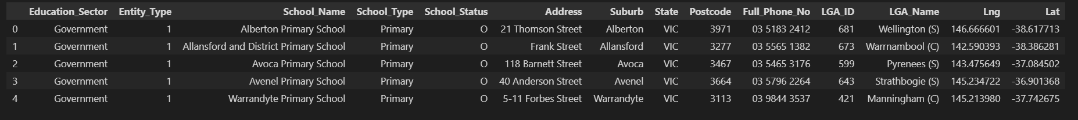
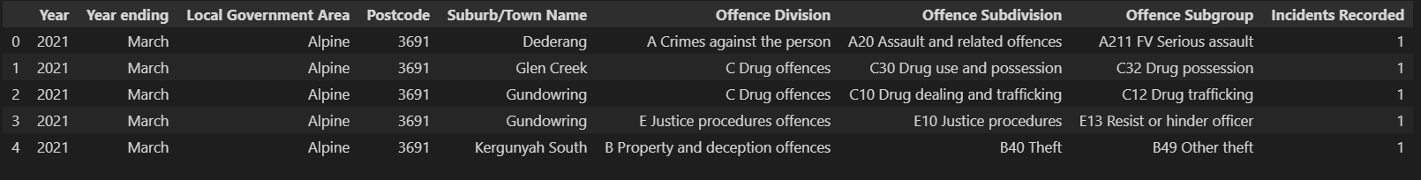
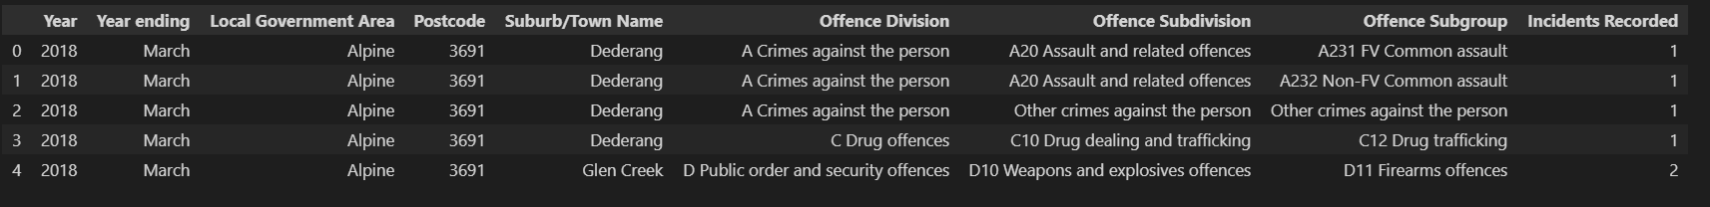
General Data Cleaning
Before
After
Drop rows that contains no sales record
Drop unwanted columns
Rename column names for easier recognition
Before
After
Before
After

Slide 6

Data used for analysis
House sales record from 2016 – 2018 that covers over 30,000 record and 345 suburbs – from Kaggle
List of all the schools in Melbourne – no school rating – from Victoria Government website
Crime rate data – Victoria Government website
Latitude, Longitude of center of suburbs and surrounding train stations – Google API call

Slide 7
HypothesIs 1:
A positive relationship between the house price and the number of train station surrounding the suburb

Slide 8
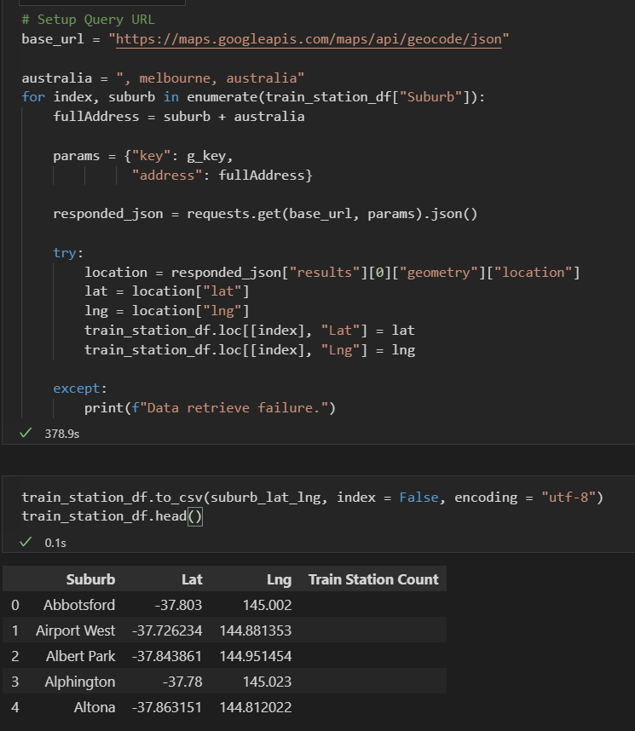
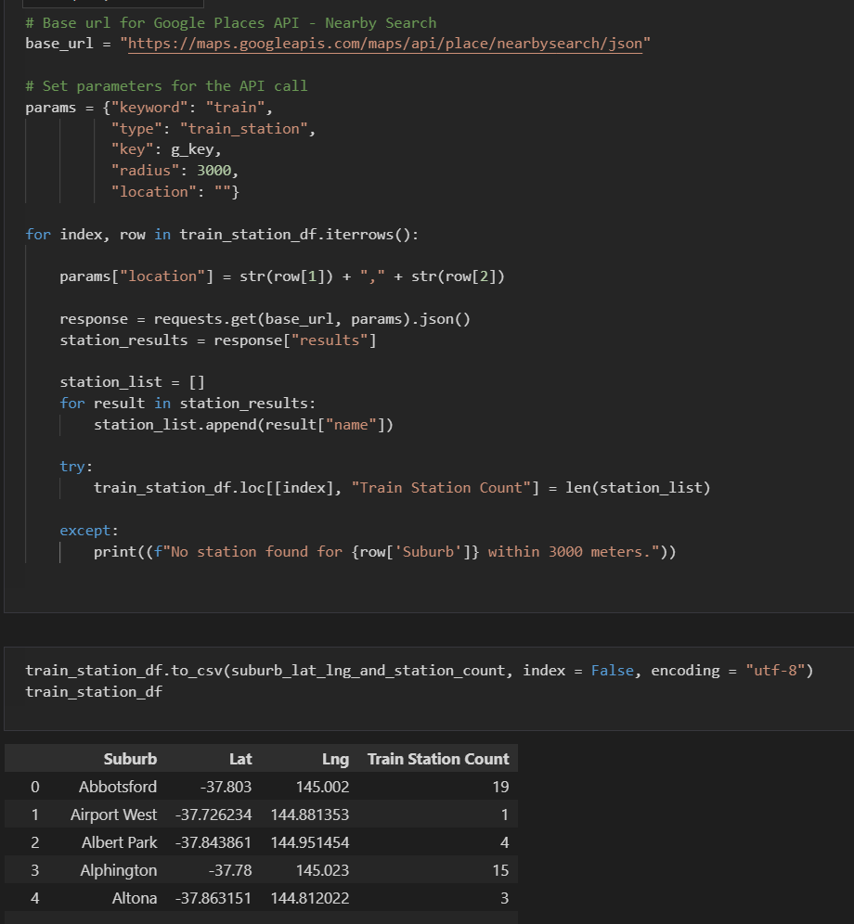
Collect Data via Google API call

Slide 9
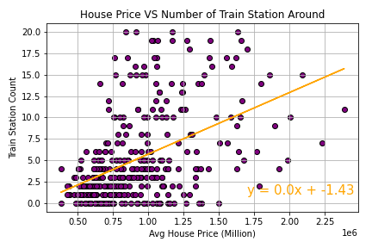
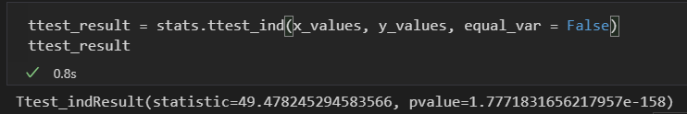
Conclusion based on this analysis: House price and number of train stations surrounding have a positive relationship

Slide 10
hypothesis 2:
The distance from CBD has direct correlation to the house pricing.
The closer to the CBD, the higher the house price

Slide 11
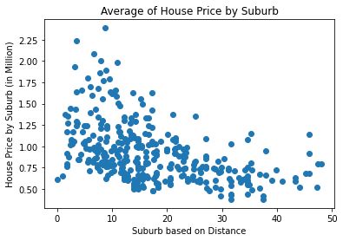
All house prices in all suburbs
Correlation Coefficient : -0.46 0.3 <r <0.5 => Weak Relationship
Notes:
Nasrin – explain the X-axis and Y-axis

Slide 12
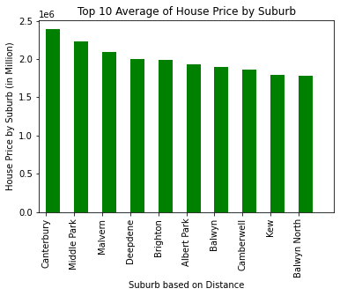
Top 10 highest house prices by suburbs
Downward Trend

Slide 13
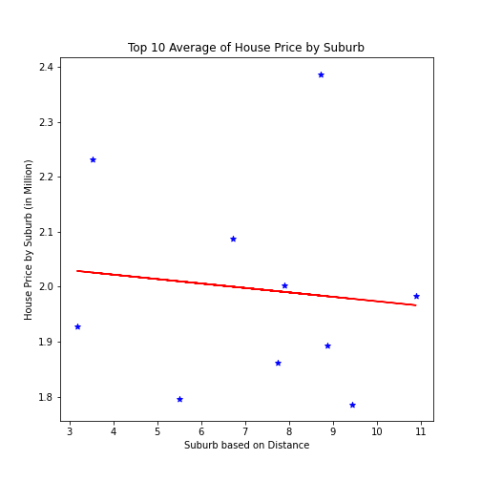
Top 10 highest house prices by suburbs
Y= -0.01 X + 2.05
Correlation Coefficient : -0.46 <0.5 P-value: 0.77 >0.05 (H0) is approved

Slide 14
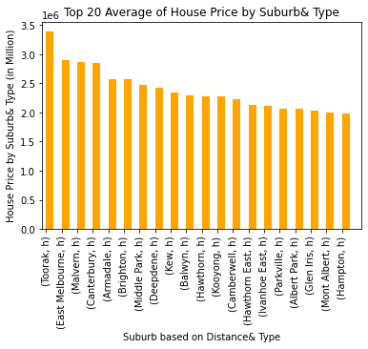
Top 20 highest house prices by suburb & type
Downward Trend (House Type: House)

Slide 15
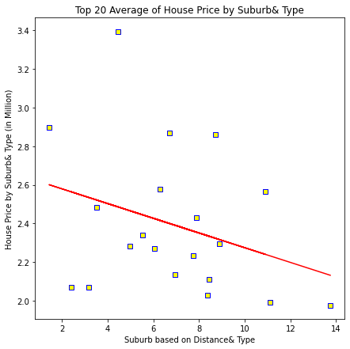
Top 20 highest house prices by suburbs & type
Y= -0.04 X + 2.66 Correlation Coefficient : -0.31 <0.5 P-value: 0.17 >0.05 (H0) is approved

Slide 16
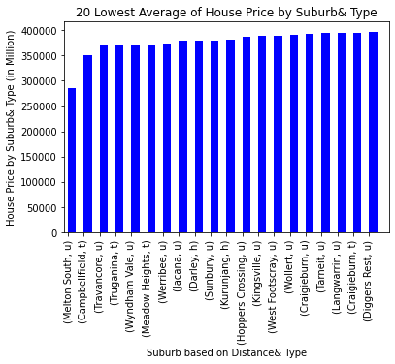
20 lowest house prices by suburb& type
Upward Trend Majority townhouse and unit type

Slide 17
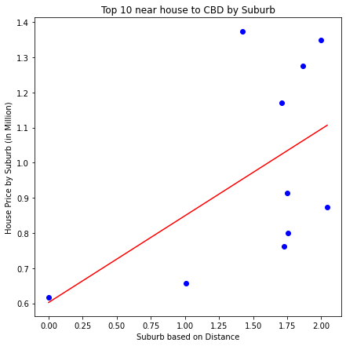
Top 10 nearest house to CBD by suburb
Y= 0.25 X + 0.6 Correlation Coefficient : 0.53 >0.5 P-value: 0.11 >0.05 (H0) is approved

Slide 18
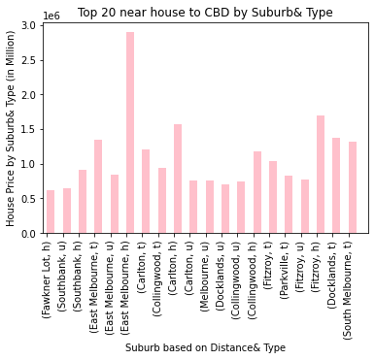
Top 20 nearest houses to CBD by suburb & type
Upward Trend All house type

Slide 19
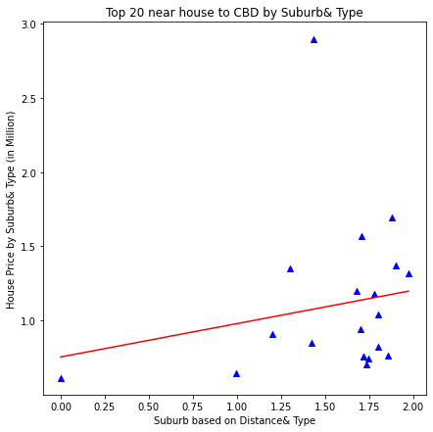
Top 20 nearest houses to CBD by suburb & type
Y= 0.22 X + 0.76 Correlation Coefficient : 0.19 < 0.5 P-value: 0.42 >0.05 (H0) is approved

Slide 20
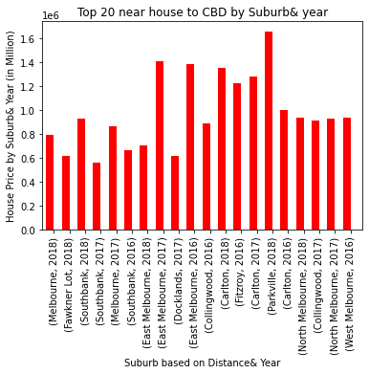
Top 20 nearest houses to CBD by suburb & year
Upward Trend Majority from 2018

Slide 21
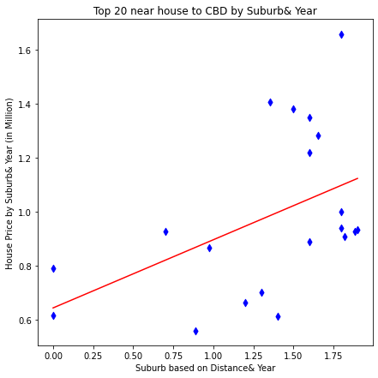
Top 20 nearest houses to CBD by suburb & year
Y= 0.25 X + 0.64 Correlation Coefficient : 0.47 < 0.5 P-value: 0.03<0.05 (H0) is rejected

Slide 22
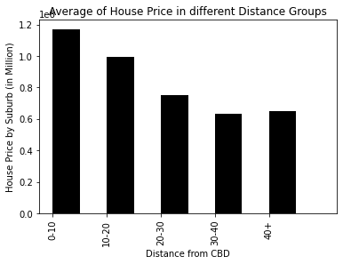
Average of house prices in different distance groups (bins)
Downward Trend

Slide 23
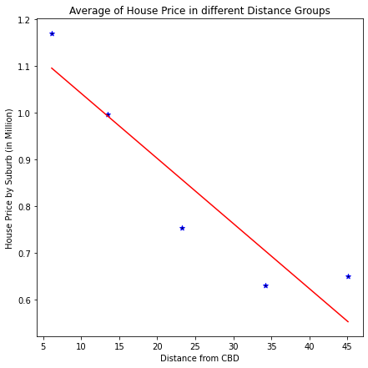
Average of house prices in different distance groups (bins)
Y= -0.01 X + 1.18 Correlation Coefficient : -0.93 > 0.5 P-value: 0.02<0.05 (H0) is rejected

Slide 24
Conclusion for Hypothesis 2:
Negative relationship between average of house price and distance to Melbourne CBD
(The closer to the CBD the higher the house price)

Slide 25
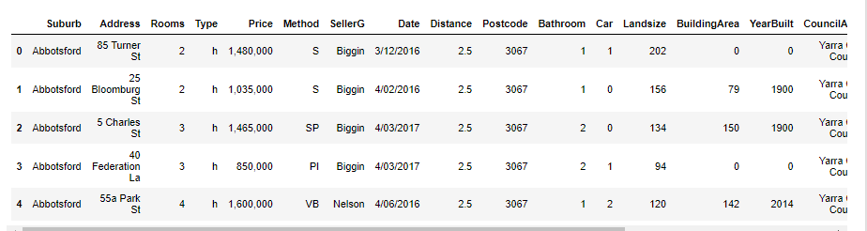
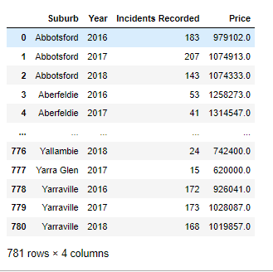
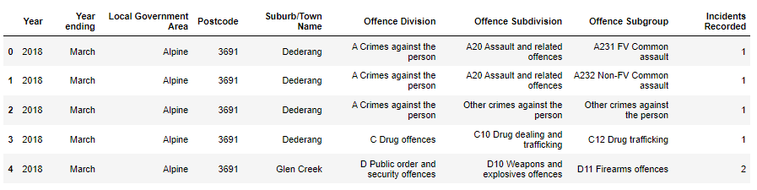
Data Cleaning
Group by (aggregate method) to see the summary results
Drop unwanted columns to make readings easier
Crime dataset- initial we have >100k rows and 9 columns
Final dataset has only 3 columns
Merge both data frames
Rename column names for easier understanding
Housing data – changing the datatype of the sales price – from object to float

Slide 26
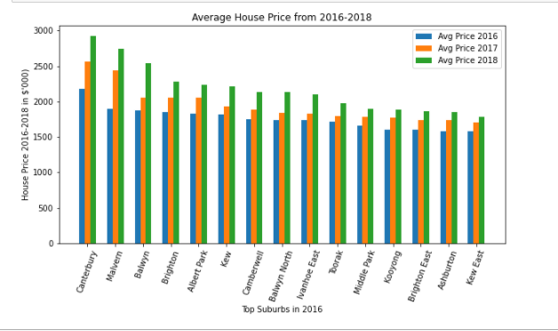

Look at the Past market trends
Top Suburbs house prices trend

Slide 27
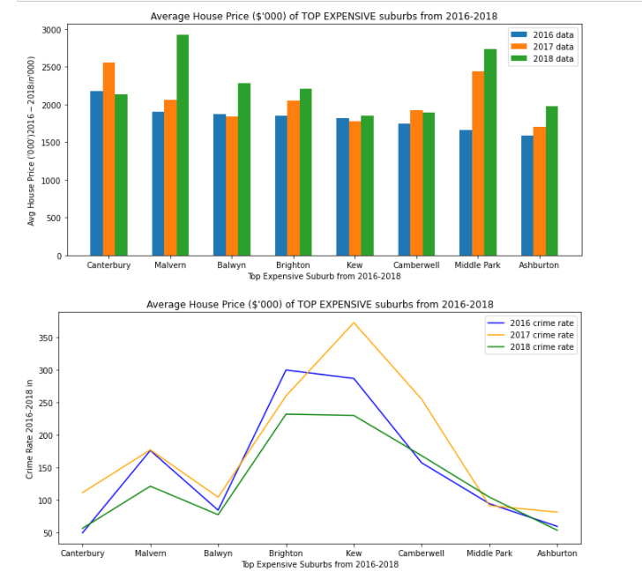
Evidence of Data Exploration
Select the top expensive suburbs from 2016-2018
Find out the crime rate (2016-2018) for the selected suburbs

Slide 28
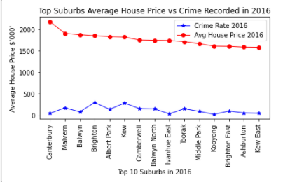
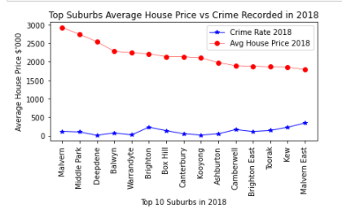
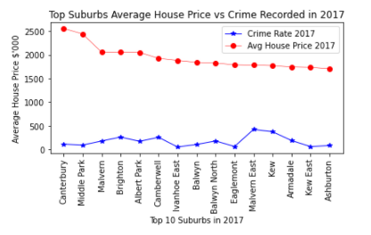
Deep Dive – The top expensive suburbs for each year How does the crime rate look like?
The most expensive suburbs that will have lower crime rate?
Seems like some less expensive suburbs also have low crime rate….

Slide 29
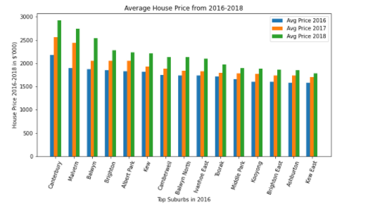
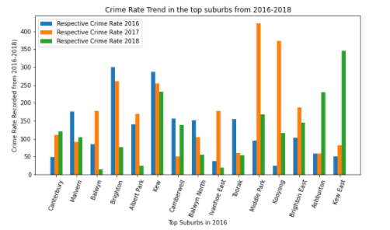
Narrowing down… Only selecting the top suburbs in 2016 to see the trend over the years

Slide 30
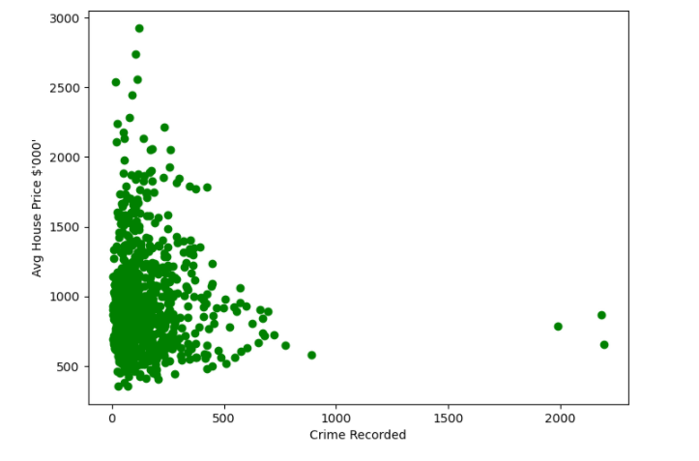
Evidence of Data Exploration Scatter plot
We have paired numerical data
Trying to find out if the two variables are related
For this instance, trying to find out if CRIME RATE is the potential cause of the rise of house price?
Crime rate vs Avg House Price (by the suburbs)
(2016 – 2018)

Slide 31
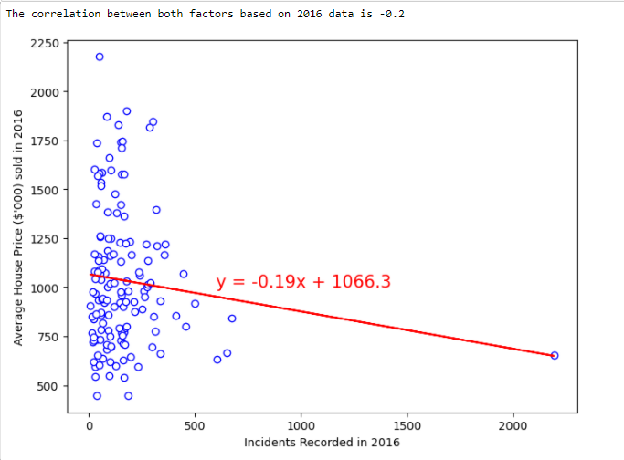
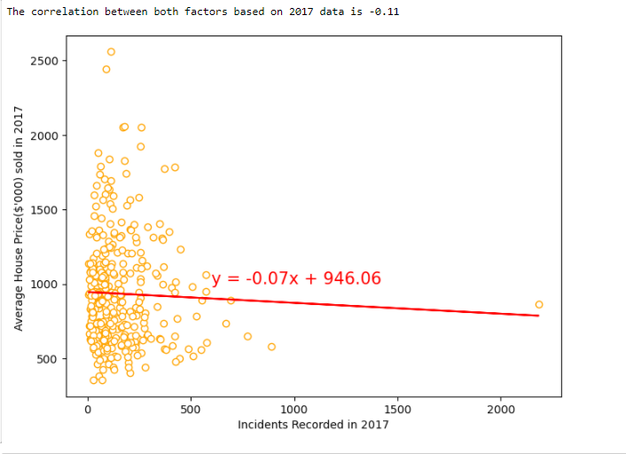
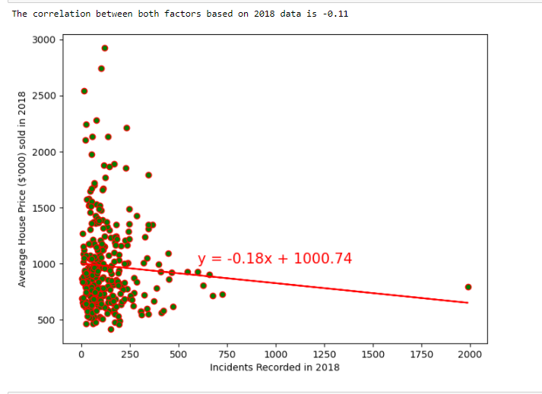
Data Exploration Scatter plot for each year
Crime rate vs Avg House Price (by the suburbs)
- Negative correlation…?

Slide 32
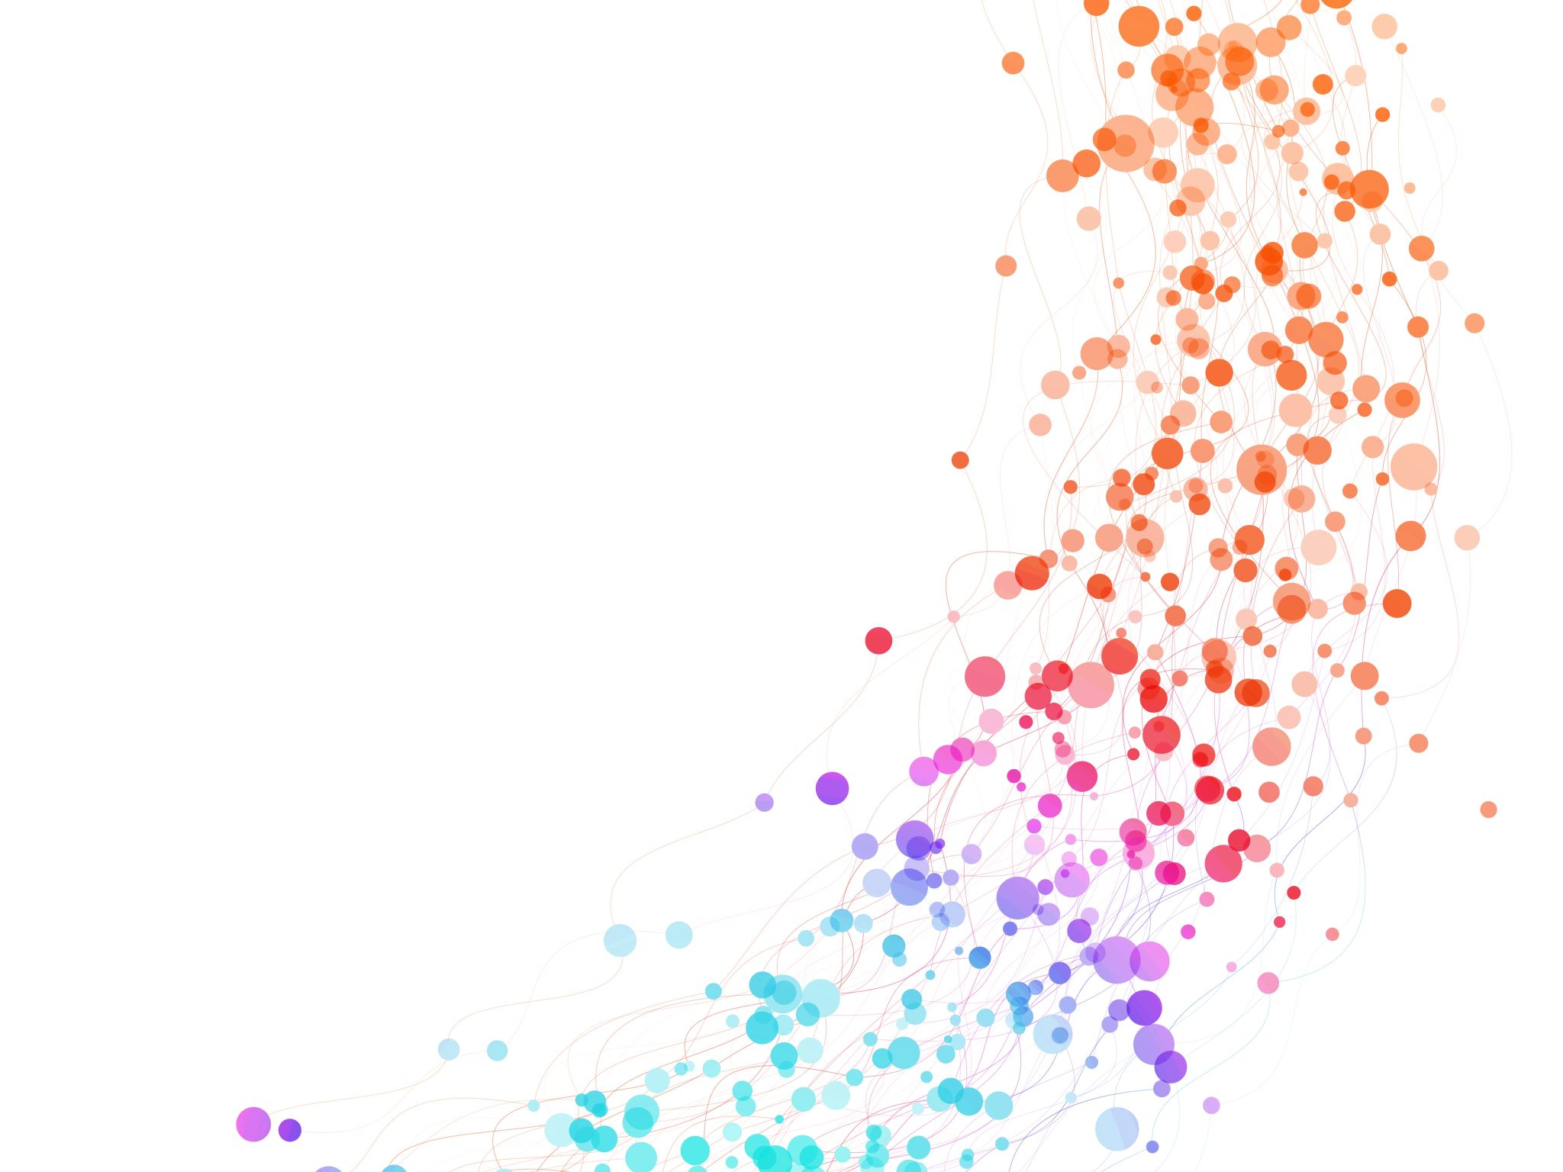
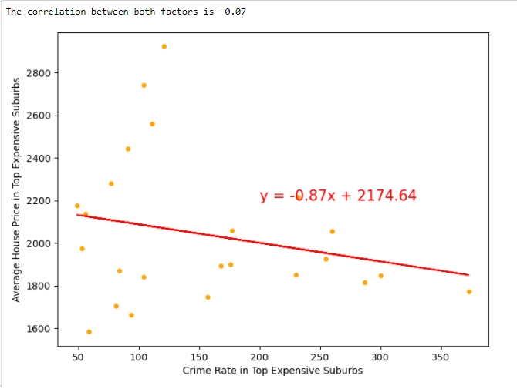
Correlation Analysis for Top Expensive Suburbs
Negative correlation between the two factors

Slide 33
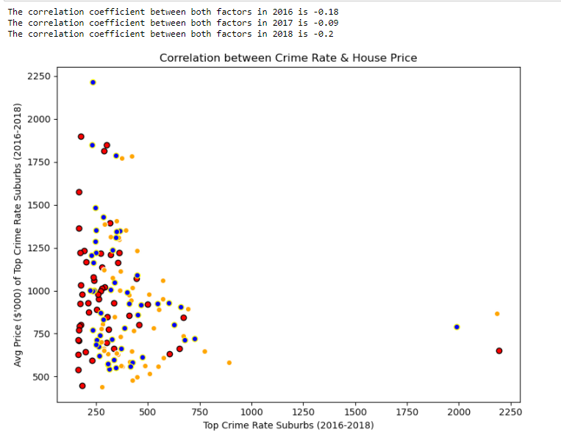
Correlation Analysis for Top Crime Rate Suburbs
Top crime rate suburbs for each year, with their average house price
It seems like there’s a negative correlation between both factors

Slide 34
Summary of findings
Overall data exploration by each year
Top expensive suburbs vs Crime rate– by each year
Top crime rate suburbs vs House Price – by each year
Back to Hypotheses:
Crime rate will affect the house price negatively.
This proves that the hypotheses is correct
Positive house price trend
Crime rate varies for each year
Negative correlation
Negative correlation

Slide 35
HypothesIs 3:
Crime rate will affect the house price negatively. The higher the crime rate in the suburb, the less likely the house price will increase

Slide 36
hypothesis 4:
School is one of the main reasons for the surge in house prices of specific suburb. Both private and public school play a big role when it comes to choosing the right suburb to live in.

